Slide 1
Tensorboard
Visualization Toolkit

Slide 2
Visualizations and Tooling
Tracking and Visualization of metrics
Visualizing the model graph (ops and layers)
Viewing histograms of weights, biases, or other tensors as they change over time
Projecting embeddings to a lower dimensional space
Displaying images, text, and audio data
Profiling TensorFlow programs

Slide 3
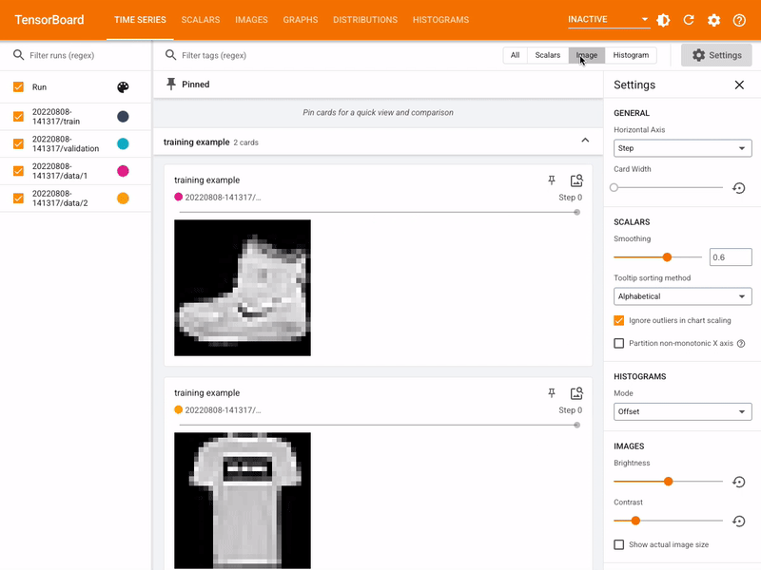
Tensorboard

Slide 4
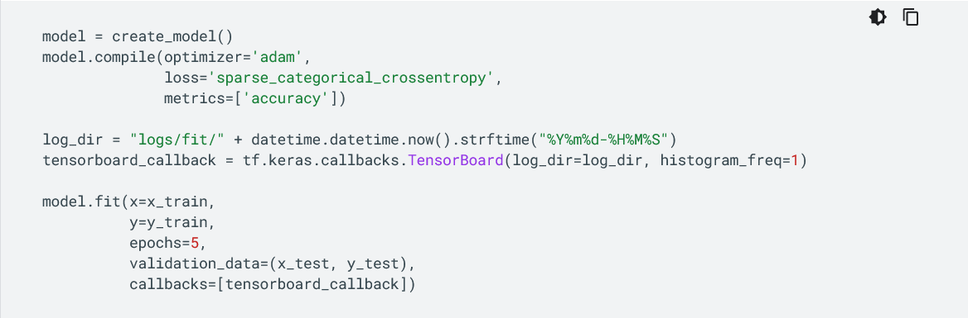
Adding Tensorboard

Slide 5
OpenMMLab
Computer Vision Open Source Project

Slide 6
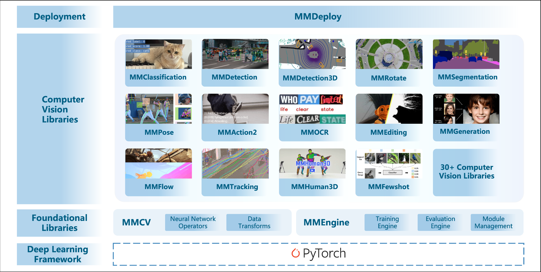
OpenMMLab Framework

Slide 7
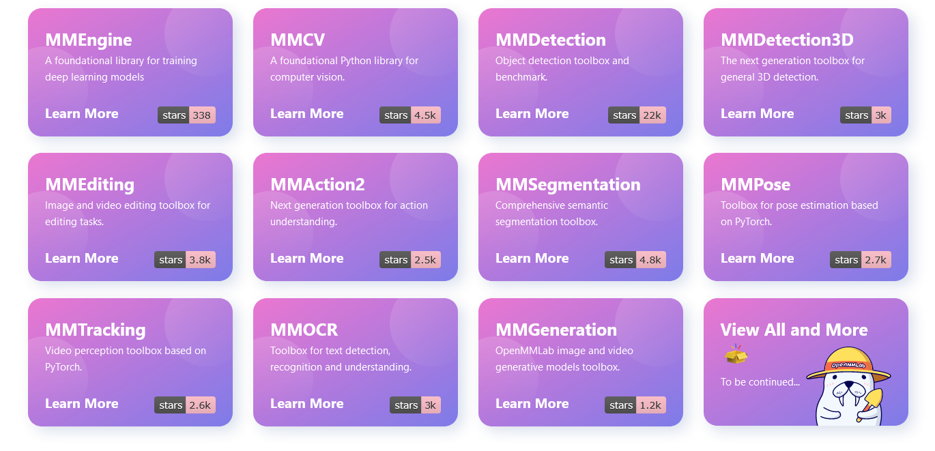
Projects in OpenMMLab Framework

Slide 8
MMDetection
Modular Design
Out-of-the-box framework support
Efficient Model
State of the art implementations
Object Detection Toolbox

Slide 9
MMDetection Components
APIs
Structures
Datasets
Models
Engine
Evaluation
Visualization
https://mmdetection.readthedocs.io/en/v3.0.0rc0/overview.html

